Slide 1
Number Strategies
Topic: Subtraction
EQ: What strategies can we use to subtract numbers and money?
Mrs Stretch
Year 10 OLNA

Slide 2
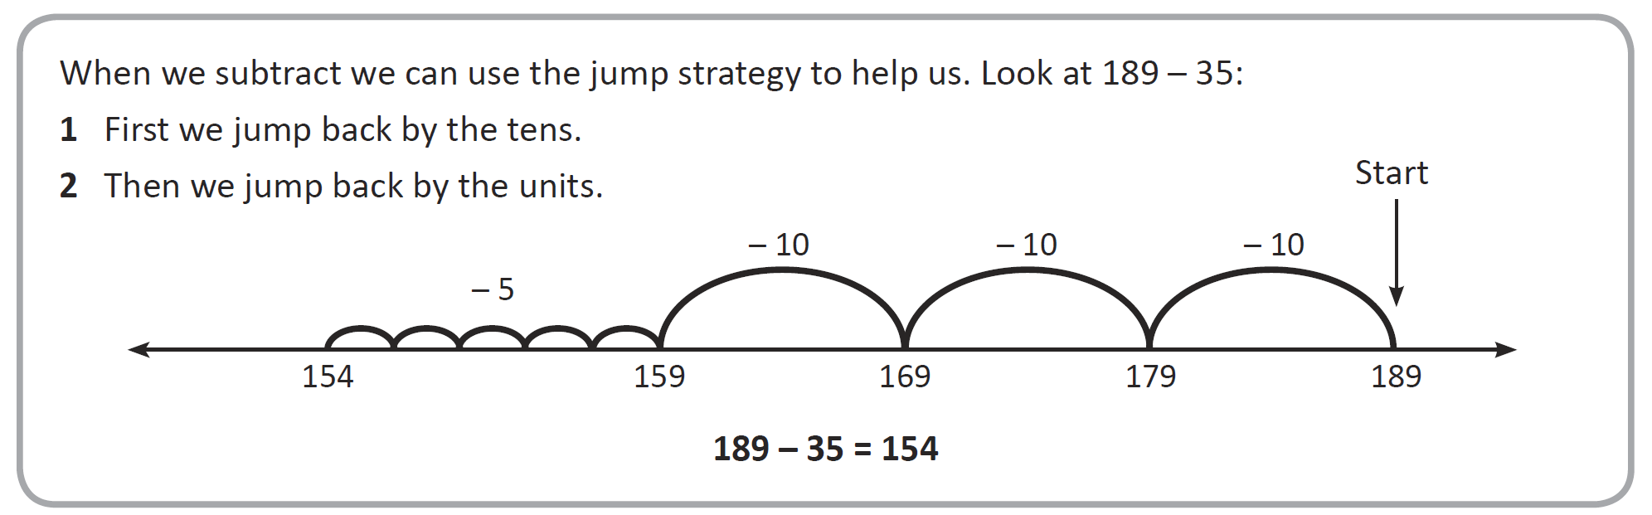
24
7
30
Subtraction
Date
EQ – What strategies can we use to subtract numbers and money?
Mental Strategy 1
Jump Method

Slide 3
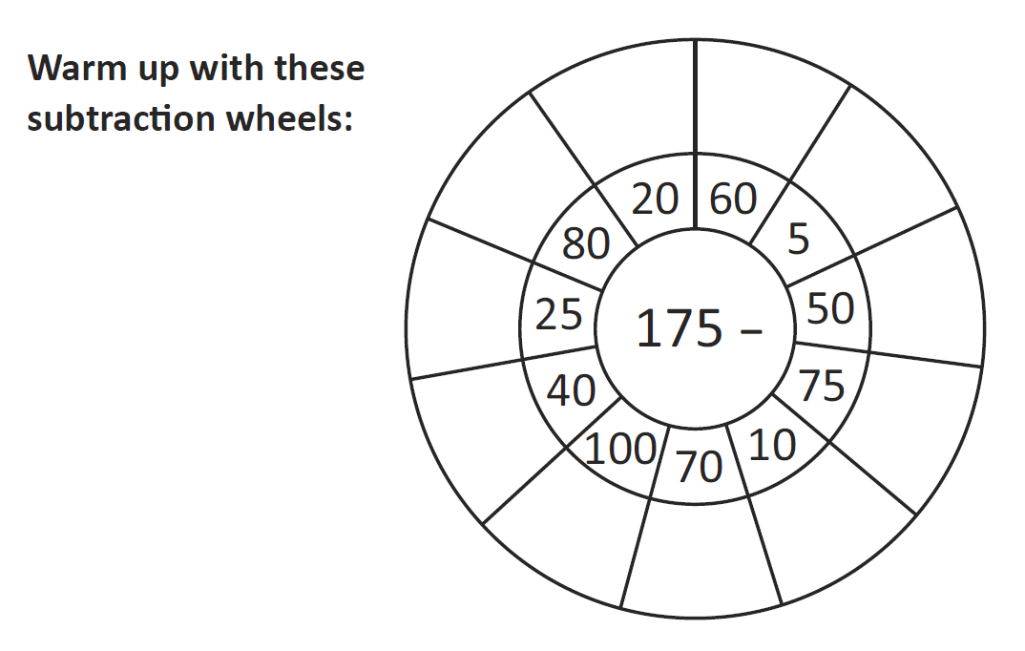
Practice

Slide 4
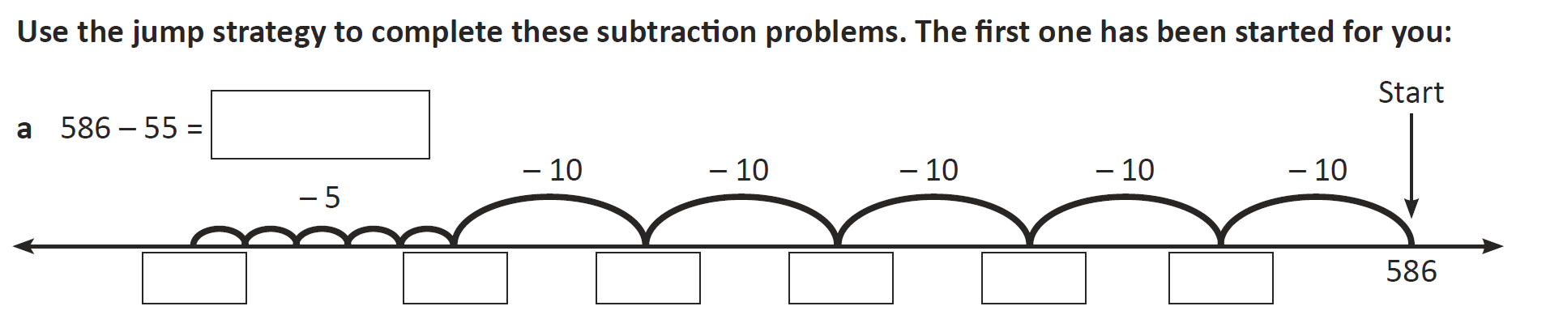
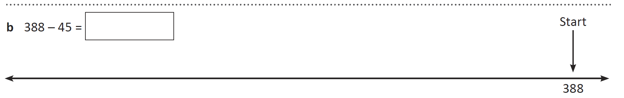

Slide 5
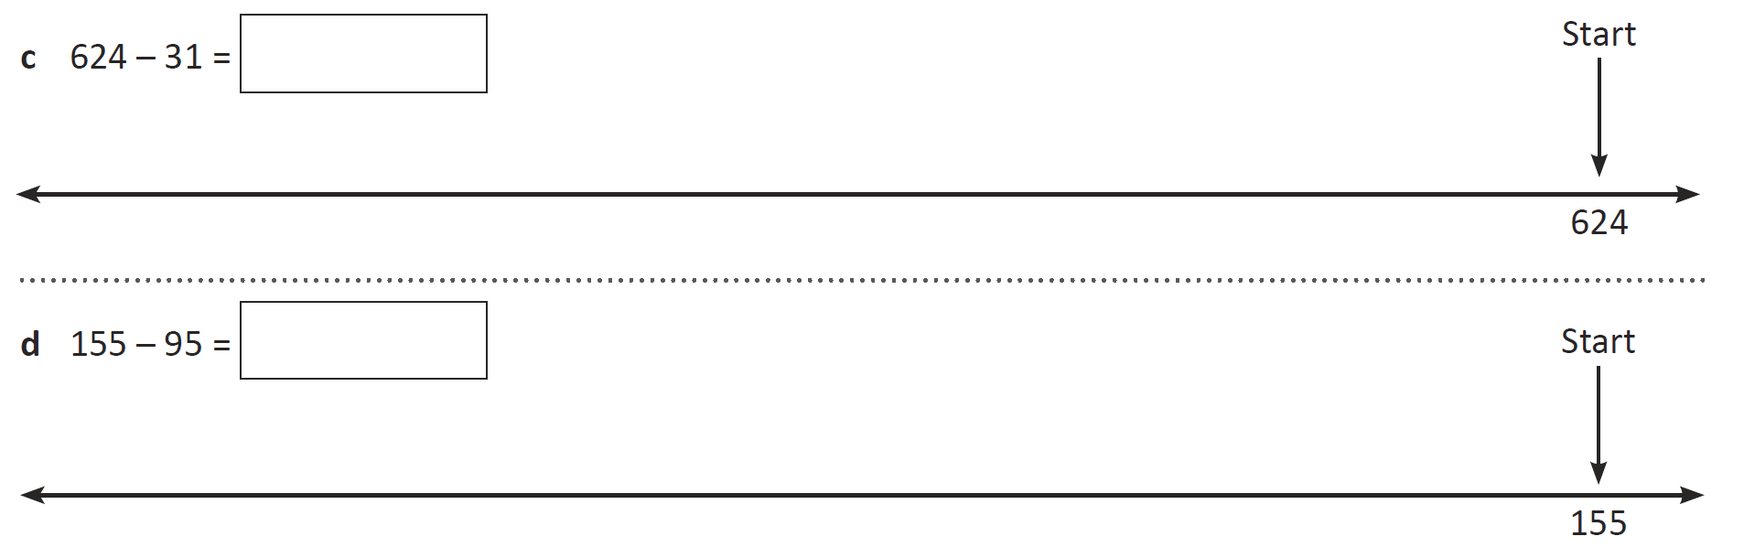

Slide 6
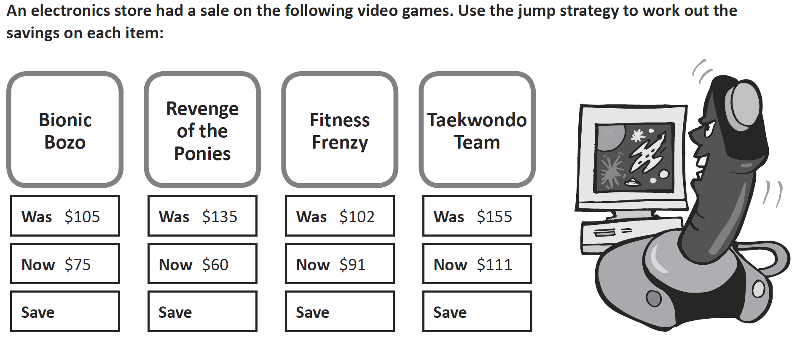

Slide 7


Slide 8
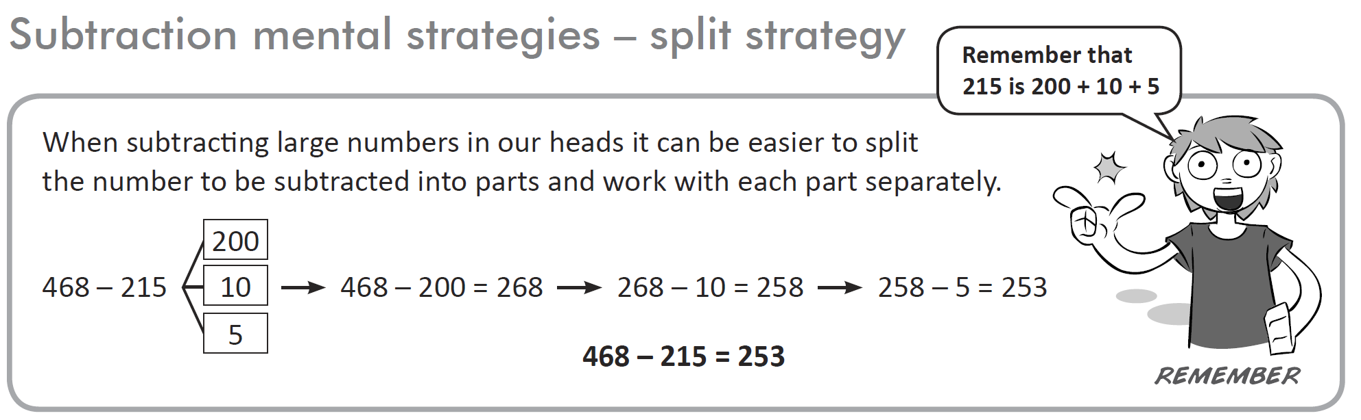
24
7
30
Subtraction
Date
EQ – What strategies can we use to subtract numbers and money?
Mental Strategy 2
Split Method

Slide 9
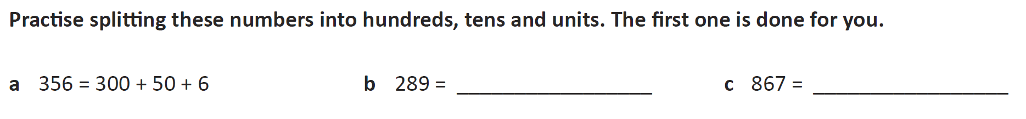
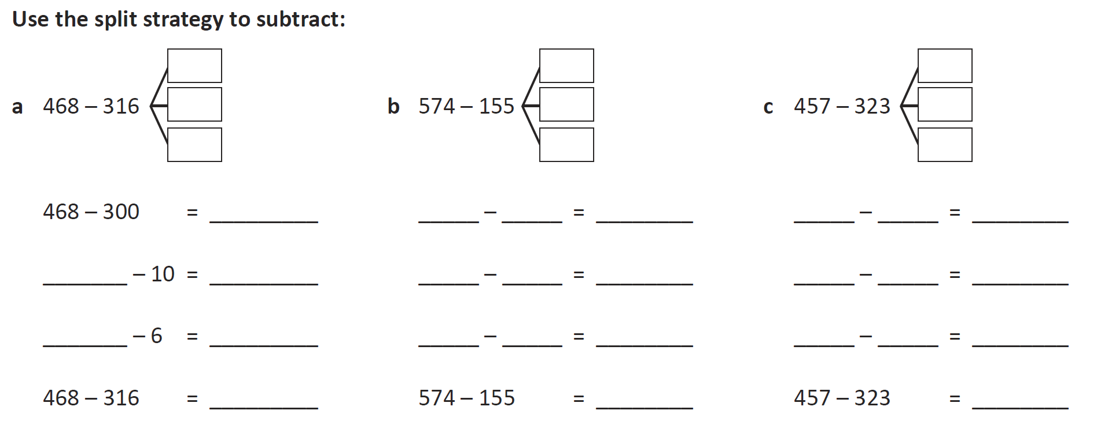

Slide 10
